Slide 1


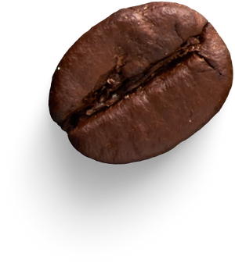
Coffeehouse Sales
Trends
- Himanshu Pathak

Slide 2


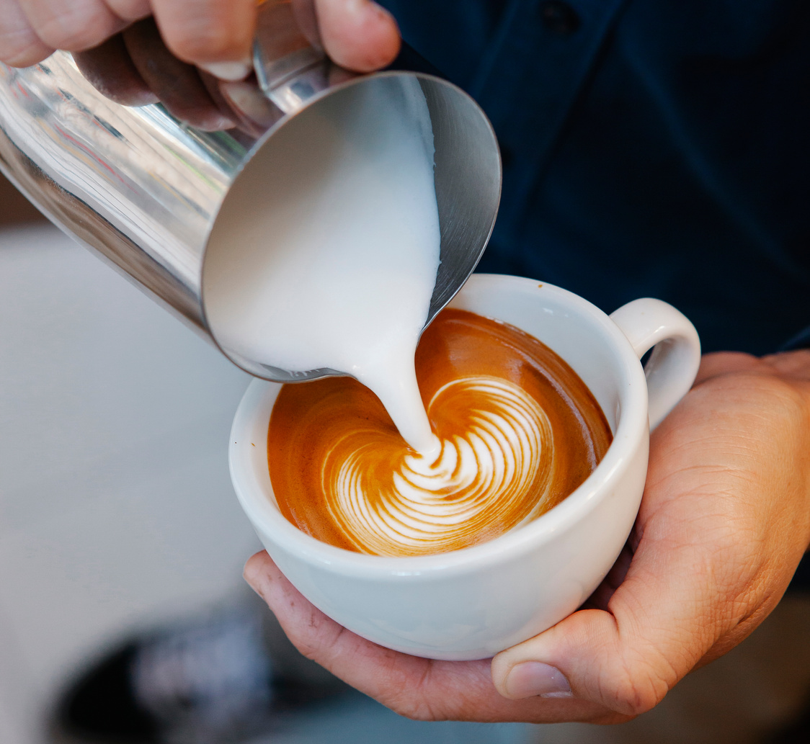

Introduction
Coffeehouse Sales Trends: Uncovering the Secrets of Coffee Sales ☕📊
From Bean to Cup: The Fascinating Story of Coffee Sales
Objective
To obtain practical insights that can improve the Coffee Shop's performance by examining retail sales data

Slide 3
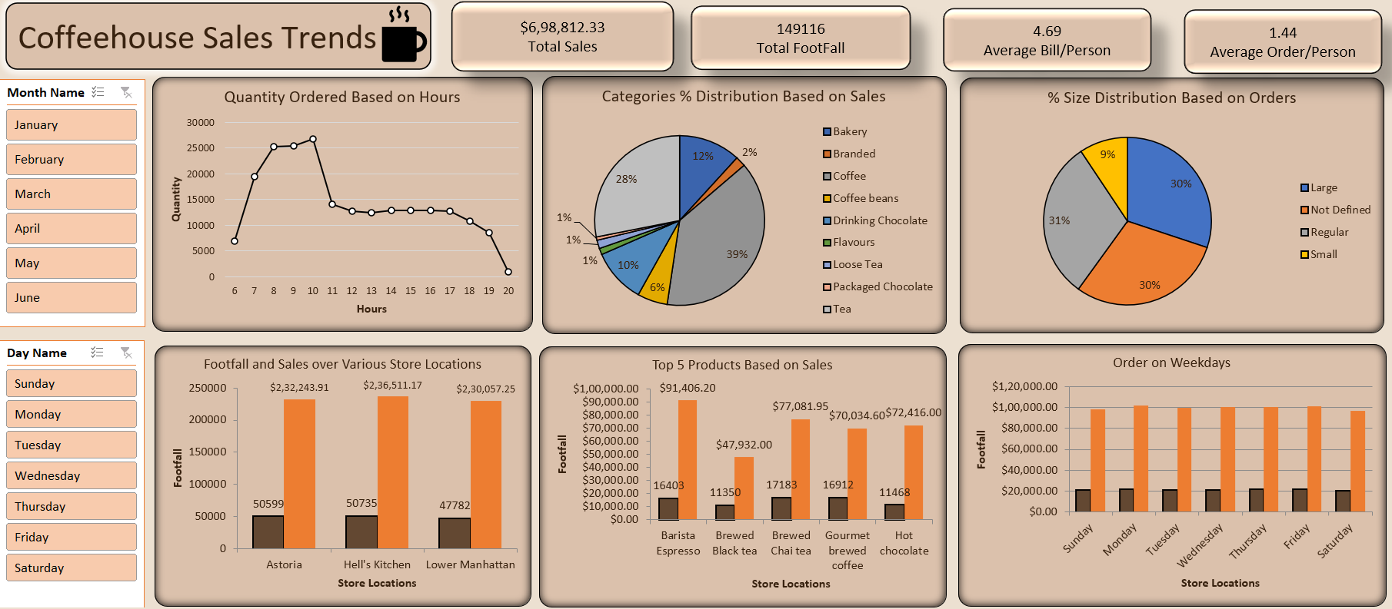
Analytics Board

Slide 4
Next steps in Analysis
How do sales vary by day of the week and hour of the day?
-> Sales Variation by Day and Hour:
Daily Sales: Sales are highest on Monday, followed by Tuesday, Wednesday, and Thursday, with a gradual decline toward the weekend.
Hourly Sales: Sales peak around 10-11 AM and then again around 7 PM, suggesting a possible breakfast rush and a dinner/evening rush. The trend seems to be decreasing after 18:00
2. Are there any peak times for sales activity?
-> Peak Times for Sales Activity:
Daily: Mondays appear to have the highest sales.
Hourly: The busiest times are likely between 10-11 AM and 7 PM.
3. What is the total sales revenue for each month?
-> The total sales revenue for each month:
January: $81,677.74
February: $76,145.19
March: $98,834.68
April: $1,18,941.08
May: $1,56,727.76
June: $1,66,485.88

Slide 5
4. How do sales vary across different store locations?
-> Sales Variation Across Store Locations:
The "Footfall and Sales over Various Store Locations" chart shows that the "Hell's Kitchen" location has the highest footfall and sales, followed by "Lower Manhattan" and "Astoria".
5. What is the average price/order per person?
The average price per person is $4.69.
The average order per person is $1.44.
6. Which products are the bestselling in terms of quantity and revenue?
The bestselling products in terms of quantity and revenue are Barista Espresso, Brewed Black Tea and Brewed Chai Tea.
7. How do sales vary by product category and type?
Product Category: The "Categories % Distribution Based on Sales" chart shows the percentage distribution of sales across different categories like Coffee(39%), Tea(28%), Bakery(12%), etc.
Product Type: The "Top 5 Products Based on Sales" chart provides information on the best-selling products within specific categories (e.g., coffee, tea, chocolate).

Slide 6



Thank You
I appreciate your time and interest in our Coffeehouse Sales Trends project.
Your feedback and questions are welcome!
Stay caffeinated and keep exploring!

